Slide 1
Chapter 12
Advanced Topics of 3D Graphics
Resumes of the book
Computer Graphics using Java 2D and 3D
Computação Gráfica
Prof. Carlos Carreto
Engenharia Informática
Instituto Politécnico da Guarda

Slide 2
Objectives
Use sound in Java 3D scene graphs.
Simulate simple shadows.
Implement dynamic geometry changes.
Use off-screen rendering to capture and record rendered images.
Apply 3D texture mapping.

Slide 3

Sound
Sound has become an important component of modern multimedia applications and is often associated with graphics applications such as games.
The Java 3D API allows you to incorporate 3D Sound into the scene graph through the Sound class and its subclasses:

Slide 4
Sound
Currently Sound classes are not 100% compatible with current versions of Java, which prevents them from working properly.

Slide 5
Sound
The Sound classes are leaf nodes and are similar to Light classes.
A BackgroundSound sound is distributed evenly in space, as with the AmbientLight light.
A PointSound sound has a specific location and may be attenuated, similar to the PointLight light.
A ConeSound sound is restricted to a cone-shaped region, similar to a SpotLight light.

Slide 6
Add Sound
Create an AudioDevice. If you use a SimpleUniverse object simply call the Viewer's createAudioDevice () method:
su.getViewer().createAudioDevice();
Create a MediaContainer object to store the sound:
MediaContainer mc = new MediaContainer(url);
Create a Sound object with the sound data and add it to the scene graph:
BackgroundSound sound = new BackgroundSound();
sound.setSoundData(mc);
sound.setSchedulingBounds(bounds);
root.addChild(sound);

Slide 7
Add Sound
Create an AudioDevice:
AudioDevice audioDev = new JavaSoundMixer(su.getViewer().getPhysicalEnvironment());
audioDev.initialize();
Create a MediaContainer object to store the sound:
MediaContainer mc = new MediaContainer(url);
Create a Sound object with the sound data and add it to the scene graph:
BackgroundSound sound = new BackgroundSound();
sound.setSoundData(mc);
sound.setSchedulingBounds(bounds);
root.addChild(sound);

Slide 8
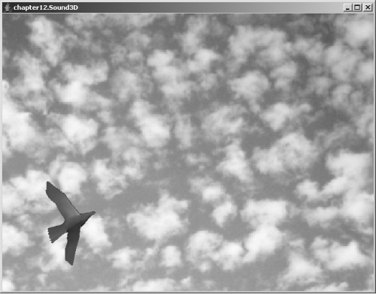
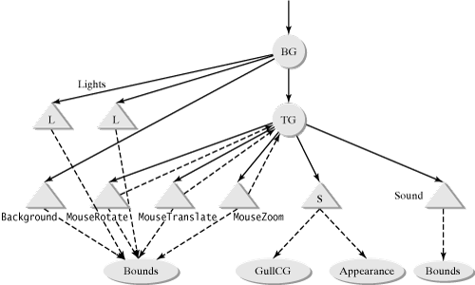
Example of a Scene With Sound
Code
Run

Slide 9
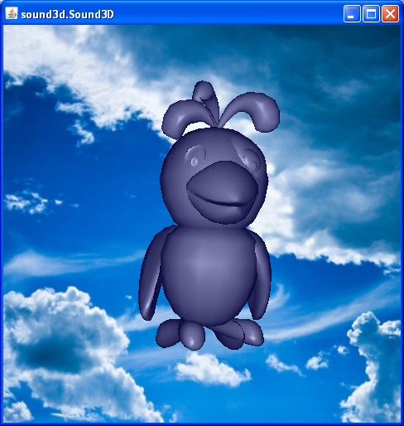
Example of a Scene With Sound

Slide 10
Example of a Scene With Sound
//System.setProperty("j3d.audiodevice",
"com.sun.j3d.audioengines.javasound.JavaSoundMixer");
//AudioDevice audioDev = su.getViewer().createAudioDevice();
AudioDevice audioDev =
new JavaSoundMixer(su.getViewer().getPhysicalEnvironment());
audioDev.initialize();

Slide 11
Example of a Scene With Sound
BackgroundSound bsound = new BackgroundSound();
URL url = this.getClass().getClassLoader().getResource("images/river.wav");
MediaContainer mc = new MediaContainer(url);
bsound.setSoundData(mc);
bsound.setLoop(Sound.INFINITE_LOOPS);
bsound.setSchedulingBounds(soundBounds);
bsound.setInitialGain(0.1f);
bsound.setEnable(true);

Slide 12
Example of a Scene With Sound
PointSound pSound = new PointSound();
url = this.getClass().getClassLoader().getResource("images/bird.wav");
mc = new MediaContainer(url);
pSound.setSoundData(mc);
pSound.setLoop(Sound.INFINITE_LOOPS);
pSound.setInitialGain(1f);
float[] distances = {1f, 20f};
float[] gains = {1f, 0.001f};
pSound.setDistanceGain(distances, gains);
pSound.setSchedulingBounds(soundBounds);
pSound.setEnable(true);
objTrans.addChild(pSound);

Slide 13
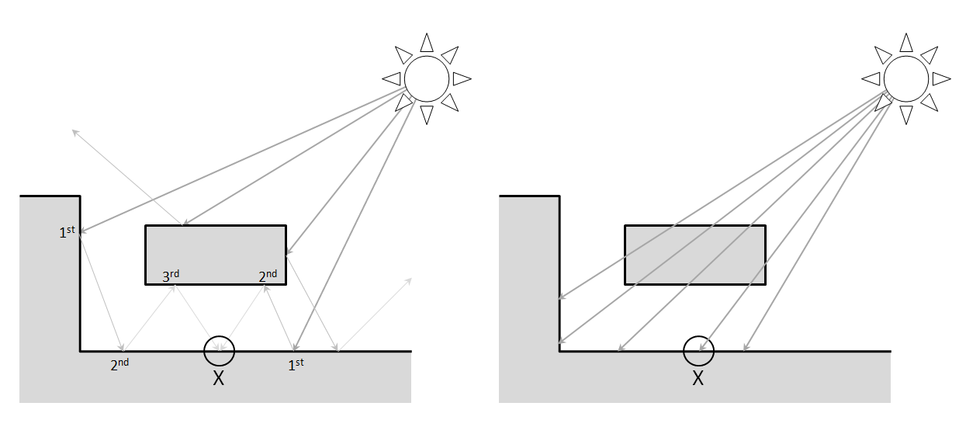
Shadow
The Java 3D API, being an API for rendering graphics in real time, uses a local (not global) lighting model.
Objects are rendered individually without consideration of the light interactions between them.
Global lighting model
Local lighting model

Slide 14
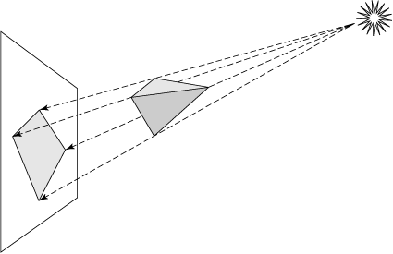
Shadow
Due to using a local lighting model, the Java 3D renderer does not automatically generate shadows.
We can use methods that allow the generation of artificial (simulated) shadows.

Slide 15
Generation of Artificial Shadow
One possible method is to generate artificial shadows by simulating them through polygons.
It is assumed that the shadow is projected onto a plane.
It is only considered the existence of a single point of light.
The vertices of the polygon that simulates the shadow are calculated by projecting the vertices of the object in the plane from the position of the light.

Slide 16
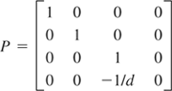
Generation of Artificial Shadow
The projection transformation is similar to the projection of the view.
In the standard form (the light located at the origin and the projection plane at x = -d), the transformation matrix is as follows:
For generic positions of light and plane, we can use an affine transformation U to map the generic configuration to the standard form. The lookAt method of the Transform3D class generates this transformation.
The final projection can be expressed by the composite transformation U⁻¹ PU.
d

Slide 17
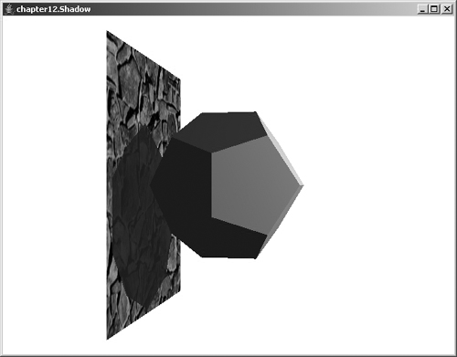
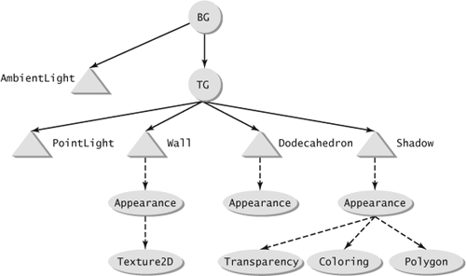
Example: Static Shadow
Code
Run

Slide 18
Example: Static Shadow
// shadow
GeometryArray shadow = createShadow(geom, lightPos, new Point3f(-2f, 3f, 1f));
ap = new Appearance();
ColoringAttributes colorAttr = new ColoringAttributes(0.1f, 0.1f, 0.1f, ColoringAttributes.FASTEST); ap.setColoringAttributes(colorAttr);
TransparencyAttributes transAttr = new TransparencyAttributes( TransparencyAttributes.BLENDED,0.35f); ap.setTransparencyAttributes(transAttr);
PolygonAttributes polyAttr = new PolygonAttributes(); polyAttr.setCullFace(PolygonAttributes.CULL_NONE); ap.setPolygonAttributes(polyAttr);
shape = new Shape3D(shadow, ap);
tg.addChild(shape);
createShadow

Slide 19
Dynamic Change of the Geometry
In some situations it is useful to dynamically (at runtime) change the geometry data in a scene graph. For example, to generate the artificial shadow of an object that moves.
The change must be made in a controlled manner so as not to interfere with the renderer's operation.
The Java 3D API provides a mechanism for modifying geometries through the GeometryUpdater interface and the BY_REFERENCE mode (for coordinate definition) of the GeometryArray classes.

Slide 20
Dynamic Change of the Geometry
When the geometry of an object is created in BY_REFERENCE mode, only references to the geometry data (coordinates) are saved by the class. The coordinates are stored externally.
Example of creating the geometry of a triangle by reference:
GeometryArray geom = new TriangleArray(3, GeometryArray.BY_REFERENCE | GeometryArray.COORDINATES);
float[] coords = {1,0,0, 0,1,0, 0,0,1};
geom.setCoordRefFloat(coords);
The coords array contains the coordinates of the geometry vertices and is referenced by the TriangleArray object.

Slide 21
Dynamic Change of the Geometry
Although the coordinates of the geometry are in the array, you should not directly alter its contents so as not to interfere with rendering engine timings.
The correct way to make changes is by implementing the GeometryUpdater interface that defines the method
public void updateData(Geometry geometry)
which must contain the code to change the geometry. The idea is for the rendering engine to internally control the call of this method.
In the program we will use the method of class GeometryArray with the same name, to request the update of the geometry:
public void updateData(GeometryUpdater updater)
But it will be the rendering engine that internally will call the interface's updateData method.
.

Slide 22
Implementing Dynamic Change of the Geometry
Create the geometry with the BY_REFERENCE mode.
Implement the GeometryUpdater interface.
Schedule the updateData (Geometry) method of the GeometryUpdater interface to perform modifications to the geometry.
Implement a Behavior class so that at the predefined intervals the updateData (GeometryUpdater) method of the GeometryArray class is called to invoke the geometry update.

Slide 23
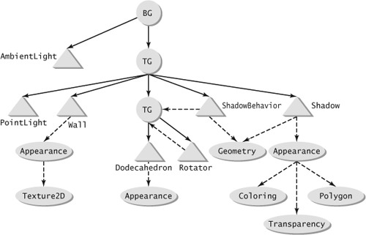
Example: Moving Shadow
Code
Run

Slide 24
Example: Moving Shadow
. . .
//A gometria da sombra é criada com GeometryArray.BY_REFERENCE
IndexedTriangleArray shadow = new IndexedTriangleArray(n, GeometryArray.COORDINATES | GeometryArray.BY_REFERENCE, count); shadow.setCapability(GeometryArray.ALLOW_REF_DATA_READ); shadow.setCapability(GeometryArray.ALLOW_REF_DATA_WRITE);
double[] vert = new double[3*n];
Point3d p = new Point3d();
for (int i = 0; i < n; i++) {
ga.getCoordinate(i, p);
Vector4d v4 = new Vector4d(p);
v4.w = 1;
shadowProj.transform(v4);
Point4d p4 = new Point4d(v4);
p.project(p4);
vert[3*i] = p.x;
vert[3*i+1] = p.y;
vert[3*i+2] = p.z;
}
shadow.setCoordRefDouble(vert);
. . .

Slide 25
Example: Moving Shadow
class ShadowUpdater implements GeometryUpdater {
public void updateData(Geometry geometry) {
double[] vert = ((GeometryArray)geometry).getCoordRefDouble();
int n = vert.length/3;
Transform3D rot = new Transform3D();
spin.getTransform(rot);
Transform3D tr = new Transform3D(shadowProj);
tr.mul(rot);
Point3d p = new Point3d();
for (int i = 0; i < n; i++) {
geom.getCoordinate(i, p);
Vector4d v4 = new Vector4d(p);
v4.w = 1;
tr.transform(v4);
Point4d p4 = new Point4d(v4);
p.project(p4);
vert[3*i] = p.x;
vert[3*i+1] = p.y;
vert[3*i+2] = p.z;
}
}
}
Applies to the points of the shadow geometry, the same transformation that is being applied to the object.

Slide 26
Example: Moving Shadow
class ShadowBehavior extends Behavior {
WakeupOnElapsedFrames wakeup = null;
public ShadowBehavior() {
wakeup = new WakeupOnElapsedFrames(0);
}
public void initialize() {
wakeupOn(wakeup);
}
public void processStimulus(java.util.Enumeration enumeration) {
shadowGeom.updateData(updater);
wakeupOn(wakeup);
}
}
The updater object is an instance of the ShadowUpdater class and contains the updateData method with the code needed to update the shadow geometry.

Slide 27
Off-Screen Rendering
Create a off-screen canvas:
public Canvas3D(GraphicsConfiguration gc, boolean offScreen)
Connect the canvas to the view:
view.addCanvas3D(canvas)
Capture images:
ImageComponent2D buffer =
new ImageComponent2D(ImageComponent.FORMAT_RGB, bImage);
canvas.setOffScreenBuffer(buffer);
canvas.renderOffScreenBuffer();
canvas.waitForOffScreenRendering();
bImage = offScreenCanvas.getOffScreenBuffer().getImage();

Slide 28
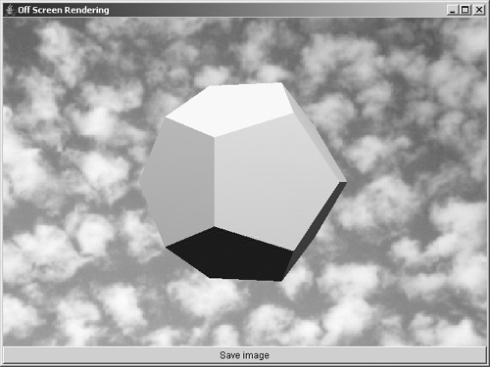
Off-Screen Rendering
Code
Run

Slide 29
Off-Screen Rendering
public BufferedImage capture() {
// render off screen image
Dimension dim = cv.getSize();
view.stopView();
view.addCanvas3D(offScreenCanvas);
BufferedImage bImage =
new BufferedImage(dim.width, dim.height, BufferedImage.TYPE_INT_RGB);
ImageComponent2D buffer =
new ImageComponent2D(ImageComponent.FORMAT_RGB, bImage);
offScreenCanvas.setOffScreenBuffer(buffer);
view.startView();
offScreenCanvas.renderOffScreenBuffer();
offScreenCanvas.waitForOffScreenRendering();
bImage = offScreenCanvas.getOffScreenBuffer().getImage();
view.removeCanvas3D(offScreenCanvas);
return bImage;
}

Slide 30
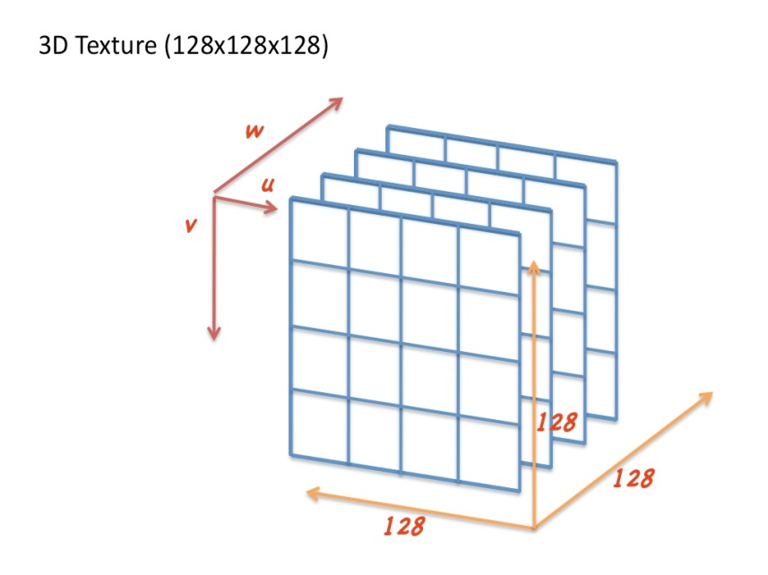
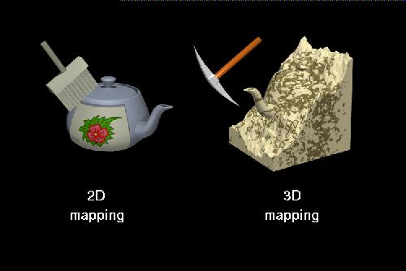
3D Textures
Mapping 3D to 3D.
Uses a "3D texture volume" as the texture source.
It consumes more computational resources in terms of generation and storage of texture data.
Produces very realistic textures based on 3D features of real objects.
http://escience.anu.edu.au/lecture/cg/Texture/printNotes.en.html

Slide 31
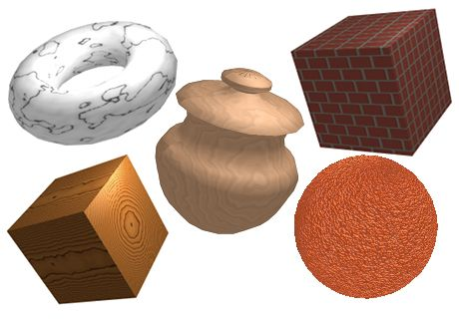
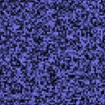

Perlin Noise
3D textures can be produced by relatively simple procedural methods such as the Perlin Noise method.
Random Noise
Coherent Noise
http://www.geepers.co.uk/?tag=procedural-textures
Code
http://freespace.virgin.net/hugo.elias/models/m_perlin.htm

Slide 32
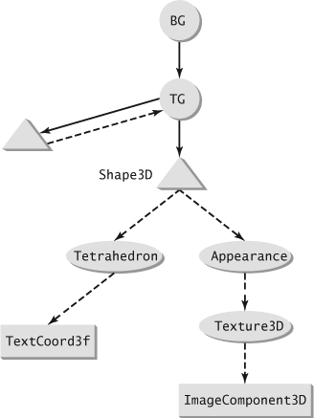
Implementation of 3D Textures
Include the TEXTURE_COORDINATE_3 flag in the GeometryArray object to allow specification of 3D texture coordinates.
Define an ImageComponent3D object from an array of BufferedImage objects that define the 3D texture volume.
Create a Texture3D object that references the ImageComponent3D object.
Add the Texture3D object as a node component referenced by the Appearance object.

Slide 33
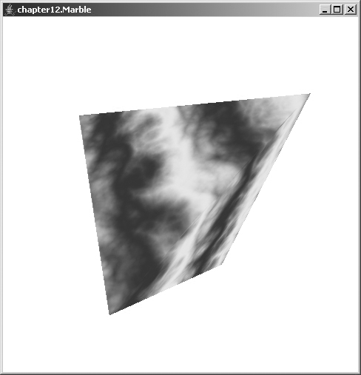
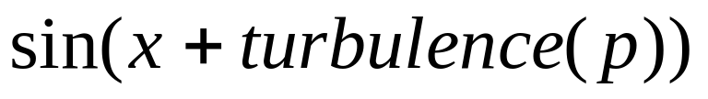
Example: Marble Texture
Code 12.10
Code 12.11
Run

Slide 34
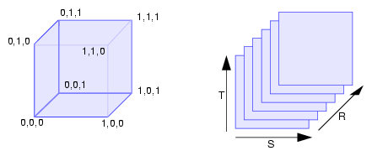
Example: Marble Texture
GeometryArray createGeometry() {
IndexedTriangleArray ga = new IndexedTriangleArray(4,
TriangleArray.COORDINATES | TriangleArray.NORMALS |
TriangleArray.TEXTURE_COORDINATE_3, 12);
. . .
ga.setTextureCoordinate(0, 0, new TexCoord3f(1f,1f,1f));
ga.setTextureCoordinate(0, 1, new TexCoord3f(1f,0f,0f));
ga.setTextureCoordinate(0, 2, new TexCoord3f(0f,1f,0f));
ga.setTextureCoordinate(0, 3, new TexCoord3f(0f,0f,1f));
ga.setTextureCoordinateIndices(0,0,coords);
return ga;
}
Coordinate system of a 3D texture.

Slide 35
Example: Marble Texture
Appearance createTextureAppearance(){
Appearance ap = new Appearance();
BufferedImage[] img = new BufferedImage[128];
for (int i = 0; i < 128; i++) {
img[i] = new BufferedImage(128,128, BufferedImage.TYPE_INT_ARGB);
for (int r = 0; r < 128; r++) {
for (int c = 0; c < 128; c++) {
double v = pnoise.turbulence(new Point3d(c/32.0, r/32.0,
i/32.0),2,2,8);
int rgb = (int)((0.55+0.35*Math.sin(3*(c/32.0+v)))*256);
rgb = ((rgb << 16) | (rgb << 8) | rgb); img[i].setRGB(c, r,
rgb);
}
}
}
ImageComponent3D image = new ImageComponent3D(ImageComponent3D.FORMAT_RGB, img);
Texture3D texture = new Texture3D(Texture.BASE_LEVEL, Texture.RGBA,
image.getWidth(), image.getHeight(), image.getDepth());
texture.setImage(0, image);
texture.setEnable(true);
texture.setMagFilter(Texture.BASE_LEVEL_LINEAR);
texture.setMinFilter(Texture.BASE_LEVEL_LINEAR);
ap.setTexture(texture);
return ap;
}

